Slide 1
ELE404
Electronics Circuits
Lecture 5
Diode’s Applications: : Logic Gates, Peak Detector, and Wave Shaping
Dr. Sattar Hussain
sattar.hussain@mryerson.ca

Slide 2
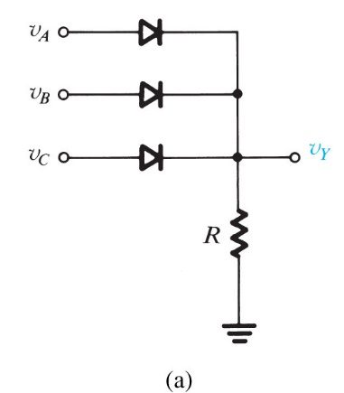
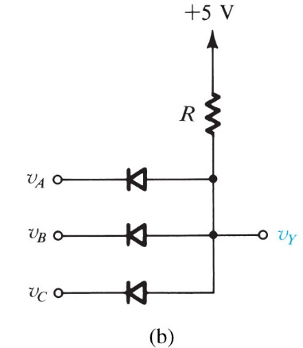
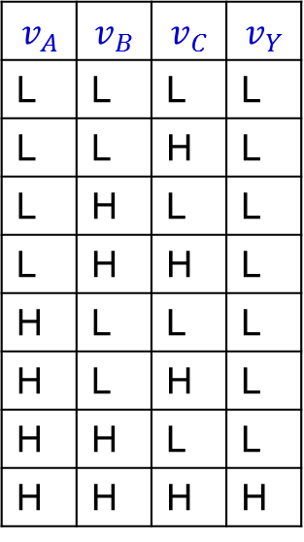
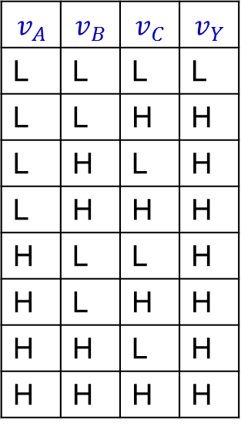


Diode Logic Gates
AND
OR
$$v_{A}$$ | $$v_{B}$$ | $$v_{C}$$ | $$v_{Y}$$
L | L | L | L
L | L | H | L
L | H | L | L
L | H | H | L
H | L | L | L
H | L | H | L
H | H | L | L
H | H | H | H
$$v_{A}$$ | $$v_{B}$$ | $$v_{C}$$ | $$v_{Y}$$
L | L | L | L
L | L | H | H
L | H | L | H
L | H | H | H
H | L | L | H
H | L | H | H
H | H | L | H
H | H | H | H
$$v_{Y}=v_{A}+v_{B}+v_{C}$$
$$v_{Y}=v_{A}.v_{B}.v_{C}$$
L = Low
H = High
Figure 4.5 Diode logic gates: (a) OR gate; (b) AND gate (in a positive-logic system).

Slide 3
Example 1: Assuming ideal diodes, analyze the OR and AND gate circuits in the previous slide. Assume that input voltages (v_{A}, v_{B} , v_{C}) take one of two levels H=5 V, and L=0 V. Find the current in the resister if R=10 kΩ. Assume ideal diodes.

Slide 4
Example 1 cont’d

Slide 5
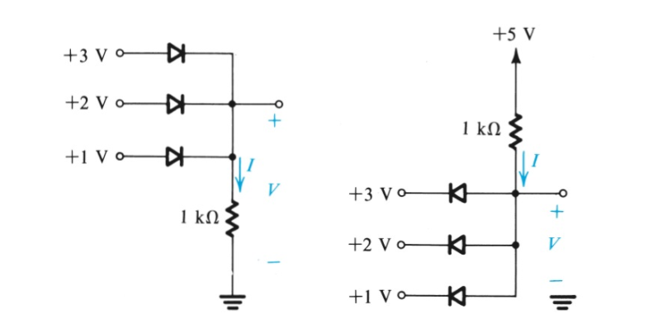
Example 2: Find the values of I and V in the circuits shown. Assume ideal diodes.
(a)
(b)

Slide 6
Example 2 cont’d

Slide 7
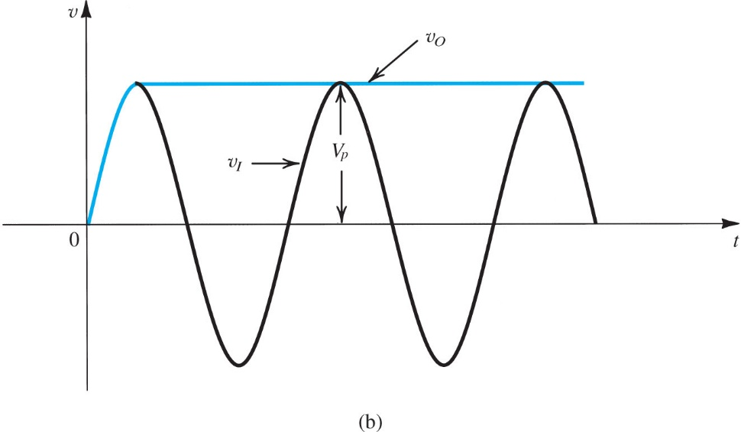
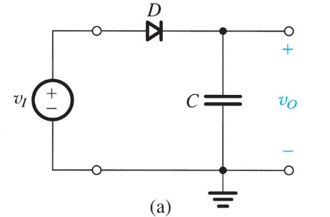
Peak Detector
The absence of the load turns the half-wave rectifier to a peak detector, whose function is to extract the peak value of the input signal V_{I}.
Peak detector has application in FM radio reception and many other application.

Slide 8
In practice, a light load (large resistance) is also added to allow for gradual discharge of the capacitor when input signal shrinks. Otherwise, the output can only go up but it will never go down should the input signal become smaller.

Slide 9
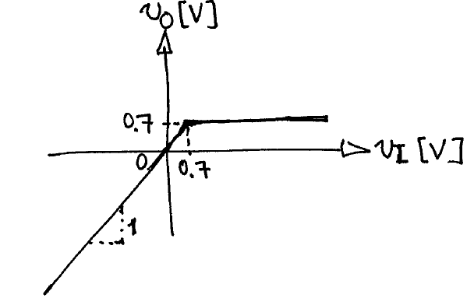
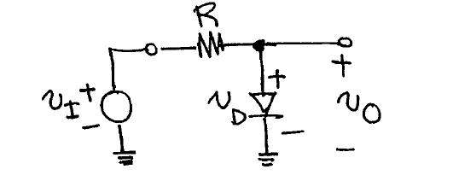
Wave Shaping Circuits-Clampers
Clippers are circuits that consists of diodes and resistors, with an input and an output, that depending on the magnitude of the input signal, either preserve the shape of the input signal or clip the input signal.
Example:
Clipping Circuit
Input-output transfer Characteristics

Slide 10
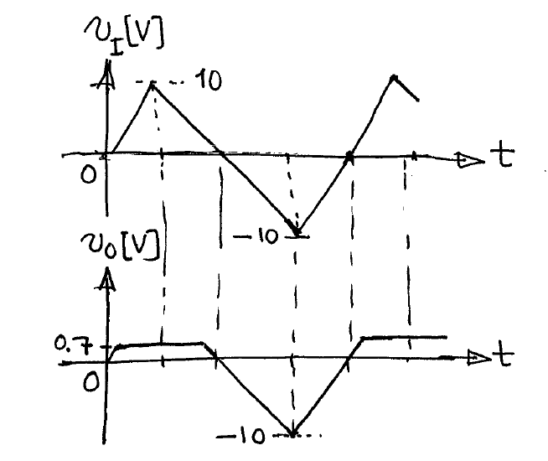
The transfer characteristics indicates that the output voltage is equal to the input voltage, as long as the input is lower than or equal to 0.7 V, and then becomes constant at 0.7 V for any input voltage larger than 0.7 V.
Let’s consider that the input voltage is a triangular periodic waveform. The output voltage is as shown

Slide 11
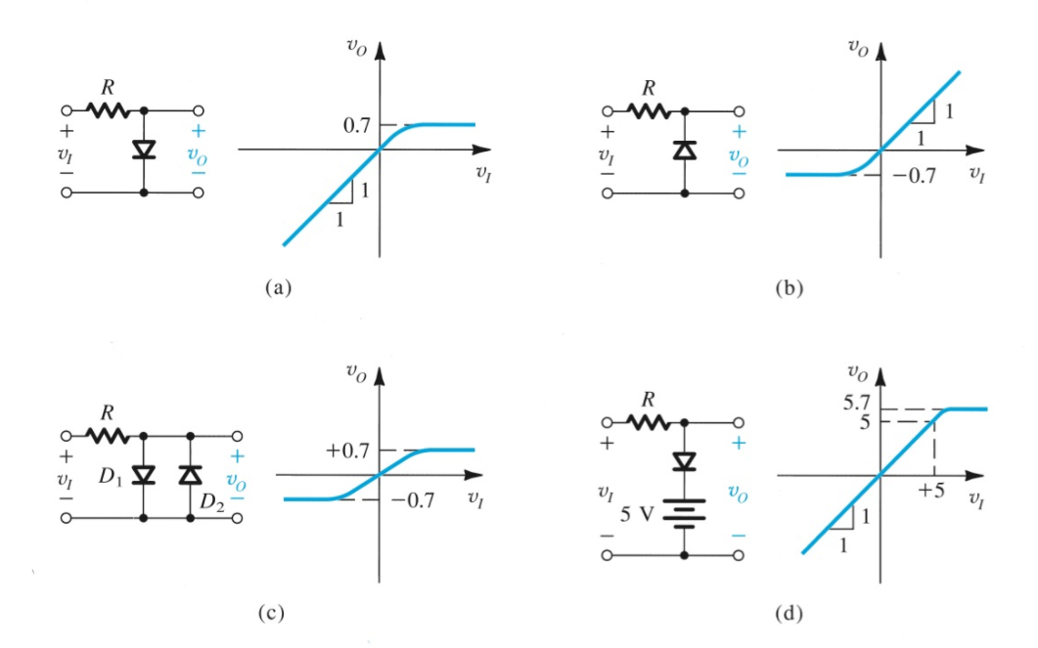
Other examples:

Slide 12
It is noted that parts of the input waveform appears at the output, while some other parts are clipped.
It should, however, be borne in mind that clippers (wave shapers) are nonlinear circuits and then is no systematic way to analyze them. The techniques that we practice just try to mitigate this inherent difficulty.
The following facts are worth noting:
The transfer characteristics of a diode circuit is continuous but a number of break points.

Slide 13
The number of break points is not larger than the number of diodes. In a well-designed circuit, the number of break points equals the number of diodes.
At any input voltage that corresponds to a break point, only one of the diodes changes its conduction state (unless the number of break points is smaller than the number of diodes)
Based on the aforementioned facts, the following algorithm can be exercised for deriving the transfer characteristic of a diode circuit:

Slide 14
Start from an input voltage of -∞ and determine the conduction states of the diodes
Formulate the output (usually a voltage, but can be a current, alternatively) in terms of v_{I}, for the conduction state determined in step 1.
Formulate the validity criterion for the conduction state of each diode, in terms of v_{I}, and, based on the derived inequalities, determine at what next larger input voltage a diode (and which diode) changes its conduction state.

Slide 15
For the new conduction state, and for an input voltage larger than the input voltage found in step (c), repeat step (b).
Stop the algorithm once all conduction state combinations have been covered.
The algorithm above is illustrated by the following examples:

Slide 16
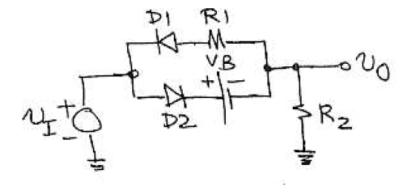
Example 3:
Derive and sketch the input-output transfer characteristic of the circuit below. Assume constant-voltage model for diodes with 0.7 V of voltage drop.

Slide 17
Example 3 cont’d

Slide 18
Example 3 cont’d

Slide 19
Example 3 cont’d

Slide 20
Example 3 cont’d

Slide 21
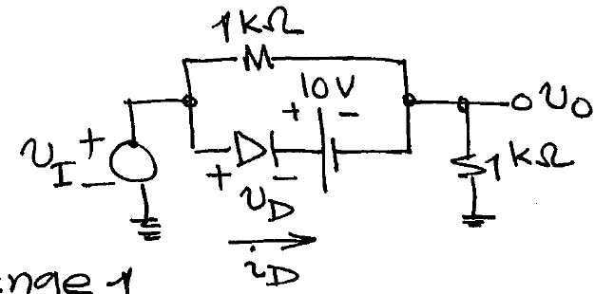
Example 4
Assuming the ideal diode model, derive and sketch the v_{I}-v_{o} characteristics of the following wave shaper.

Slide 22
Example 4 cont’d

Slide 23
Example 4 cont’d

Slide 24
Example 4 cont’d

Slide 25
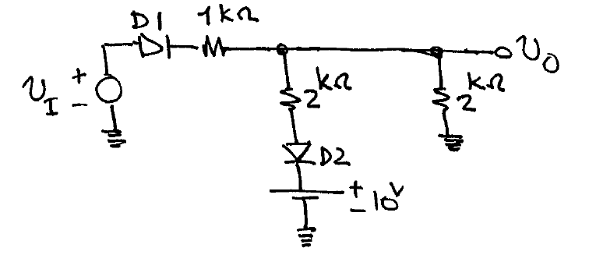
Example 5
Assuming the ideal diode model, derive and sketch the v_{I}-v_{o} characteristics of the following wave shaper.

Slide 26
Example 5 cont’d

Slide 27
Example 5 cont’d

Slide 28
Example 5 cont’d

Slide 29
Example 5 cont’d

Slide 30
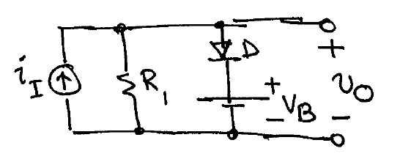
Example 6
Derive and sketch the input-output transfer characteristic of the circuit below. Assume constant-voltage model for diodes with 0.7 V of voltage drop.

Slide 31
Example 6 cont’d

Slide 32
Example 6 cont’d

Slide 33
Example 6 cont’d

